Slide 1

A Major project on Notes Hub
Guided By-
Mr. Ishwar Lal Deshmukh
SUBMITTED BY-
Jyoti Prajapati
Yogita
Mahesh Dewangan
Chintamani Sahu
Bhupendra Kumar
Rajesh Kumar

Slide 2
POINTS OF THE PROJECT-
INTRODUCTION
OBJECTIVE
DISADVANTAGES OF EXISTING SYSTEM
ADVANTAGES OF SOFTWARE
HARDWARE SPECIFICATION
SOFTWARE SPESIFICATION
SYSTEM FLOW CHART
FLOW CHART OF ADMINISTRATOR
FLOW CHART OF USER
ER-DIAGRAM
SNAP SHOT
FUTURE ENHANCEMENT
CONCLUSION
REFERENCE

Slide 3
INTRODUCTION-
This project is develop for Govt. polytechnic Khairagarh.
It is related to notes, question papers and projects.
It contain all computer science notes .
An additional facility is, user can send their feedback, see the projects files and questions paper .

Slide 4
OBJECTIVES-
The project is providing subjects related notes, projects details and questions paper .
In this project admin is add the notes, projects and question papers as well as new users.
Admin also see the all user feedback, admin manage the all information.
This projects is very dynamic and easy to understand.

Slide 5
DISADVANTAGES OF EXISTING SYSTEM
This type of any project not used in our institute.

Slide 6
ADVANTAGES OF SOFTWARE
Notes hub provide notes according to topics, as well it provides question papers according to year and semester.
User send the feedback.
Notes hub provide project details.

Slide 7
HARDWARE SPECIFICATION -
Processor:- Pentium IV or Latest
RAM:- 1GB Minimum
Hard Disk: - 40 GB(100 MB free space)
Monitor: - LCD/LED/CRT
Key-Board: - Standard Keyboard and above

Slide 8
SOFTWARE SPECIFICATION -
Operating System:- Window Xp, Window 7 or extended
Platform:- Php5.6(version)
Front End:- Html, Css, Php
Back End:- MySQL, SQL Server

Slide 9
System Flow Diagram-
See Users
Add Notes
Add Questions paper
Admin
Add Projects files
View Feedback
Login
Send Feedback
See /download Notes
See/download Projects files
User
See /download Question paper

Slide 10
FLOW CHART

Slide 11
ADMINISTRATOR-
LOGIN
Enter User Id& Password
If Admin Email & Password Is Valid
No
Structure Privileges
Yes
Go to home page and see the notes, question papers ,projects files, users etc
Admin add notes, add question papers, add project, add new user
End

Slide 12
USER-
LOGIN
Enter User Email & Password
If User Email & Password Is Valid
No
Yes
Limited Privileges
See Notes , Question papers and send feedback
End

Slide 13
ER –DIAGRAM-

Slide 14
E-mail
Password
E-mail
Password
MANAGE
ADMIN
USER
has
Notes
has
Add
Manage
Projects files
View & download
feedback
Question paper
Add Question paper
Add Notes
Add Projects files
Notes
users
Projects files
Add new users
Questions paper

Slide 15
SNAP SHOT

Slide 16

HOME PAGE-

Slide 17

LOGIN PAGE-

Slide 18

USER AFTER LOGIN PAGE-

Slide 19
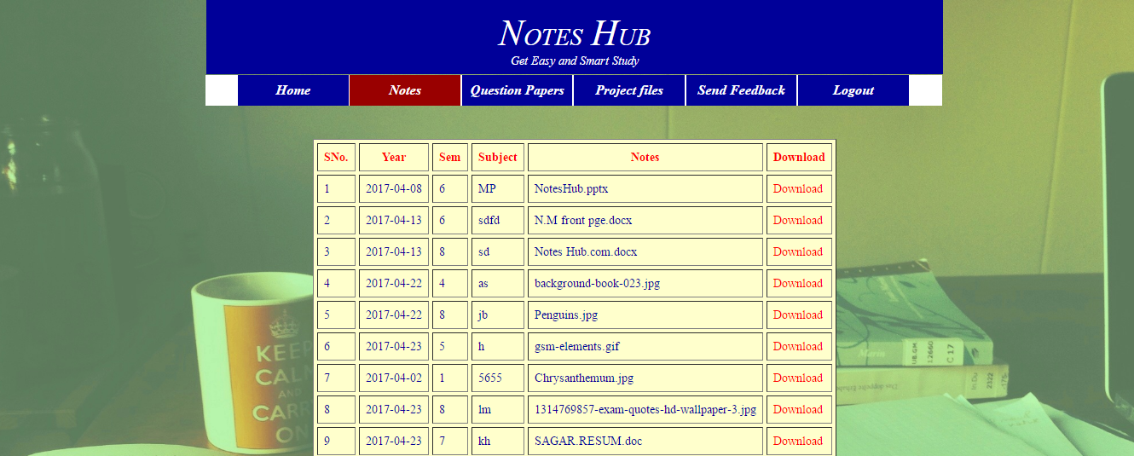
VIEW NOTES-

Slide 20
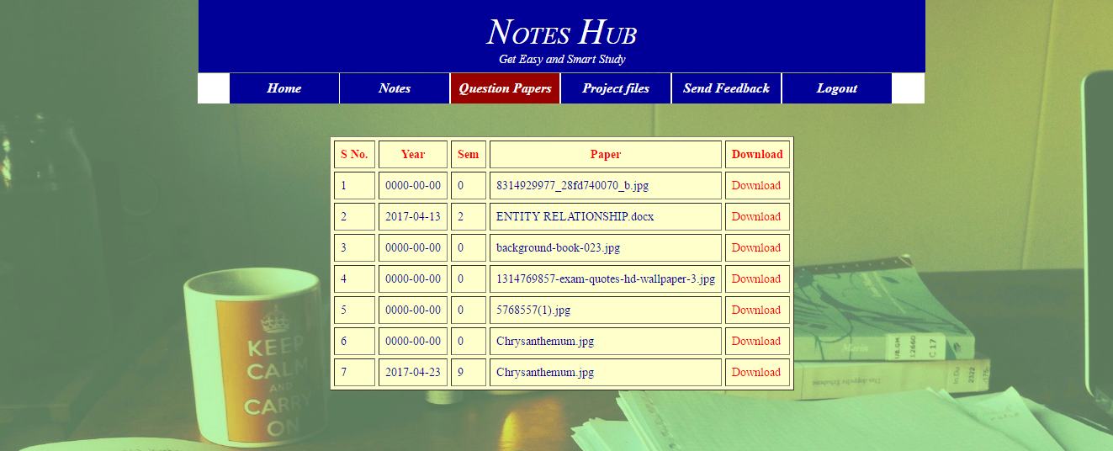
VIEW PAPERS-

Slide 21
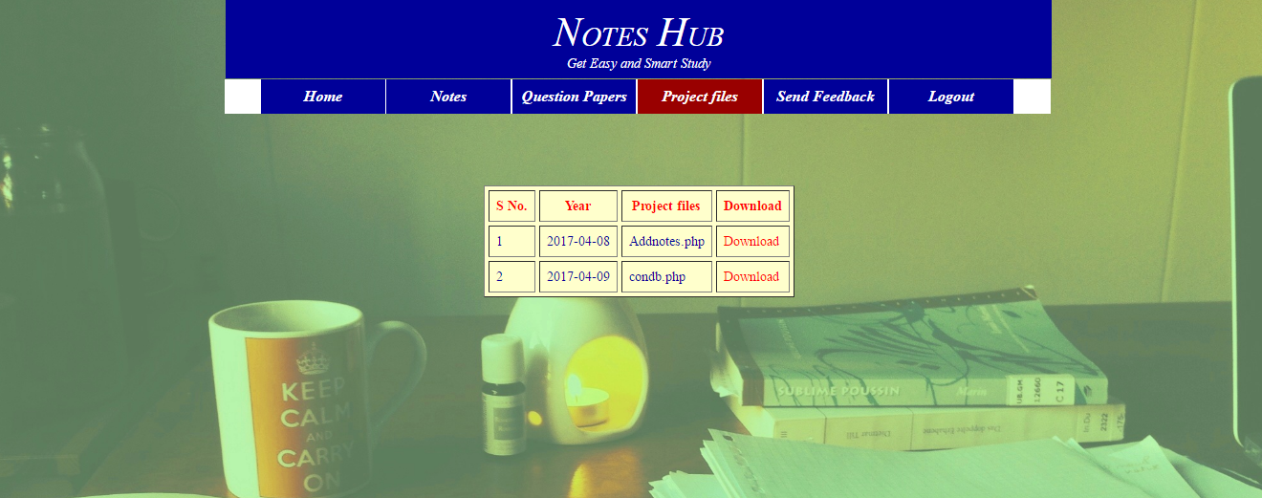
VIEW PROJECTS FILES-

Slide 22
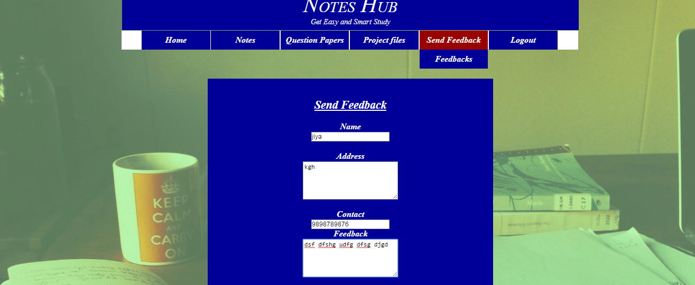
SEND FEEDBACK -

Slide 23
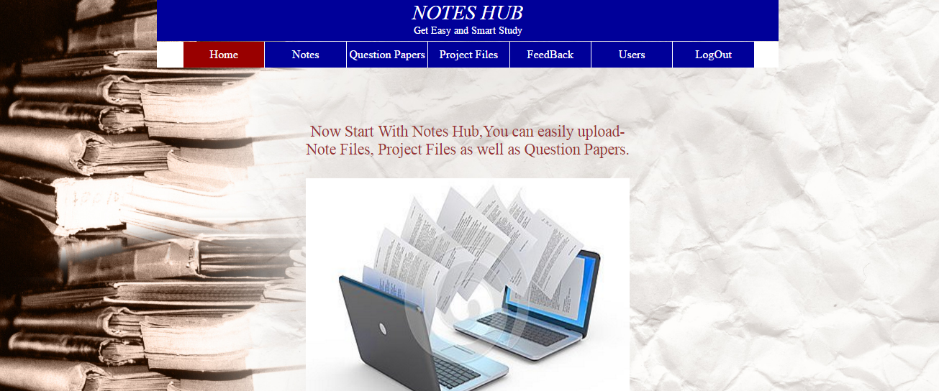
ADMIN PAGE-

Slide 24
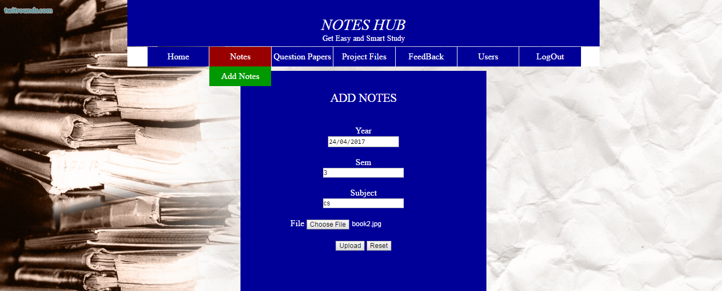
ADD NOTES-

Slide 25
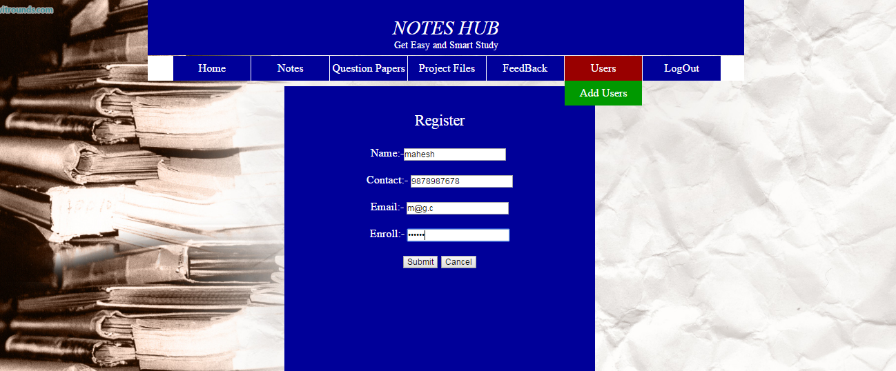
ADD NEW USER-

Slide 26
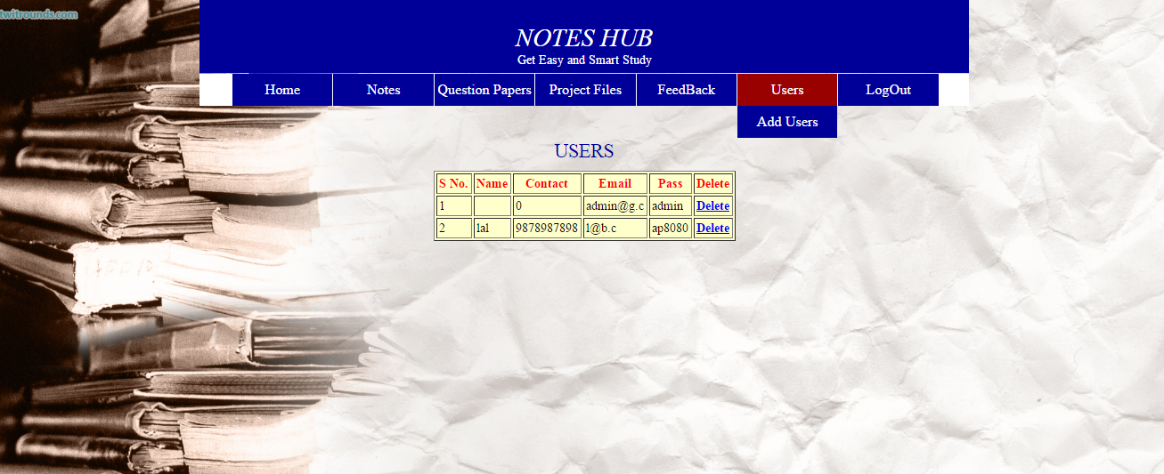
SEE USER-

Slide 27
FUTURE ENHANCEMENT-
In future we will implement some new features for other branches.
User can upload the notes.

Slide 28
CONCLUSION-
We built this project for students, with the help of this project students can easily download notes, projects files and question paper related to topic.
Some times students not having a notes and question papers for exams ,so they are prepare for exam ,this type of problem is solve with the help of this project.

Slide 29
REFERENCE-
www.tutorialpoint.com
www.w3school.com.

Slide 30
THANK-YOU

